Slide 1
Poster Template
IMPORTANT:
This slide has been configured for the screens that will be used to display your poster.
Original template dimensions are 28.584cm x 50.809cm
Do not change these dimensions, otherwise your poster may not display correctly.
If you are not using PowerPoint to create your poster, then you must ensure that your poster dimensions conforms to the same ratio as the template
Insert the 3 digit poster number in the box provided at in the top right-hand corner (see Conftool for your poster number).
Final poster must be submitted (via Conftool) in both PDF and PNG format
Recommended Font Sizes:
Title: 60min – 80max
Body Text : 22min – 32max (for best effect)
: 18 absolute min – 40 absolute max
Colour:
Solid background colours are recommended, however white should not be used as the brightness of the panel can make it difficult to read when standing in front of it.
To save your poster as an PNG image for display on the Cube:
Click File > Save As
Select PNG from the dropdown Save as type box
Click Save and select “Just This One” when prompted
Please keep a copy of your poster in the original format (eg PowerPoint) as this will allow you to go back and edit your poster again if required
Please enter your poster content on the next slide.
Please upload your final poster (PNG and PDF) by Friday 9th June 2017.

Slide 2

207
Publication Life Cycle at CERN Document Server
CERN Document Server
CERN Document Server contains a shitload of documents, photos, videos and other crap. How do we manage this crapload of documents?
Ingestion
Data can be ingested to CDS from various sources through one of the workflows:
Submission forms: during the 15+ years of running CDS, the number of different submission forms grow up to over 100. Some of them share some common elements, but at the end, every one of them is tailored to meet the specific needs of a given group.
Single and multiple records editor – a power tools for catalogers that allow them to directly submit the desired metadata.
Automatic import from other systems, like OAI Harvesting from Inspire and ArXiV, batch upload from the ATLAS experiment, etc.
Curation
Once the data is ingested and indexed at CDS, curation processes are kicking in and further improving it:
Automatic plot and captions extraction from the PDF files, cross-referencing with information in other collections (connecting conference proceedings and conference records) or in other systems (linking to Inspire or ArXiV), DOI minting are a part of the post-submission processes.
Some of the internal documents are being commented on and after passing the referral process, they are being published as public documents.
Author's disambiguation process that we run in 2016 harnessed the power of advanced machine learning tools to connect documents with their author's profiles – we have created almost 50k profiles and connected them to over 2M records (check the numbers).
Based on how people interact with CDS, we suggest them relevant/similar documents with our recommendation system (screenshot).
Export
There also multiple ways that data can be exported from CDS
Each record can be exported in one of 7 different formats: BibTeX, MARC, MARCXML, DC, EndNote, NLM and RefWorks.
Each collection of records defines it's own RSS channel.
Users can define custom notifications based on a search query.
Multimedia content can be exported to YouTube or embedded on any other website.
Other repositories can harvest records from CDS using the OAI-PMH protocol.

Slide 3

207
Publication Life Cycle at CERN Document Server
CERN Document Server hosts over 1,300,000 different documents. How does their life looks like?
Ingestion
Data is ingested from various sources through one of the workflows:
100+ submission forms created during 15 years of running CDS (don't ask how we still can still maintain them) – each tailored to meet the specific needs of a given user group.
Single- and multi-records editor – power tools for catalogers to submit the desired metadata directly.
Automatic import from other systems, like OAI Harvesting from Inspire and arXiv, batch upload from the ATLAS experiment, etc.
Curation
Ingested and indexed data is further improved through:
Automatic plots and captions extraction, cross-referencing with information from other collections or other systems (Inspire or ArXiV), automatic DOI minting.
Review process, in which the internal documents, after discussions and revisions, are being publicly published.
Authors disambiguation process that run in 2016 and, with the help of machine learning tools, enriched metadata of over 2,700,000 signatures in more that 67,000 records.
Recommendation system that, based on how people interact with CDS, suggest relevant/ or similar documents.
Export
There are multiple ways for retrieving data from CDS:
Each record can be exported in one of 7 formats: BibTeX, MARC, MARCXML, DC, EndNote, NLM and RefWorks.
Each collection of records defines it's own RSS channel.
Users can use search queries to define notifications.
Videos can be exported to YouTube or embedded on any other website.
With OAI-PMH protocol, other repositories can harvest records from CDS.
cds.cern.ch

Slide 4
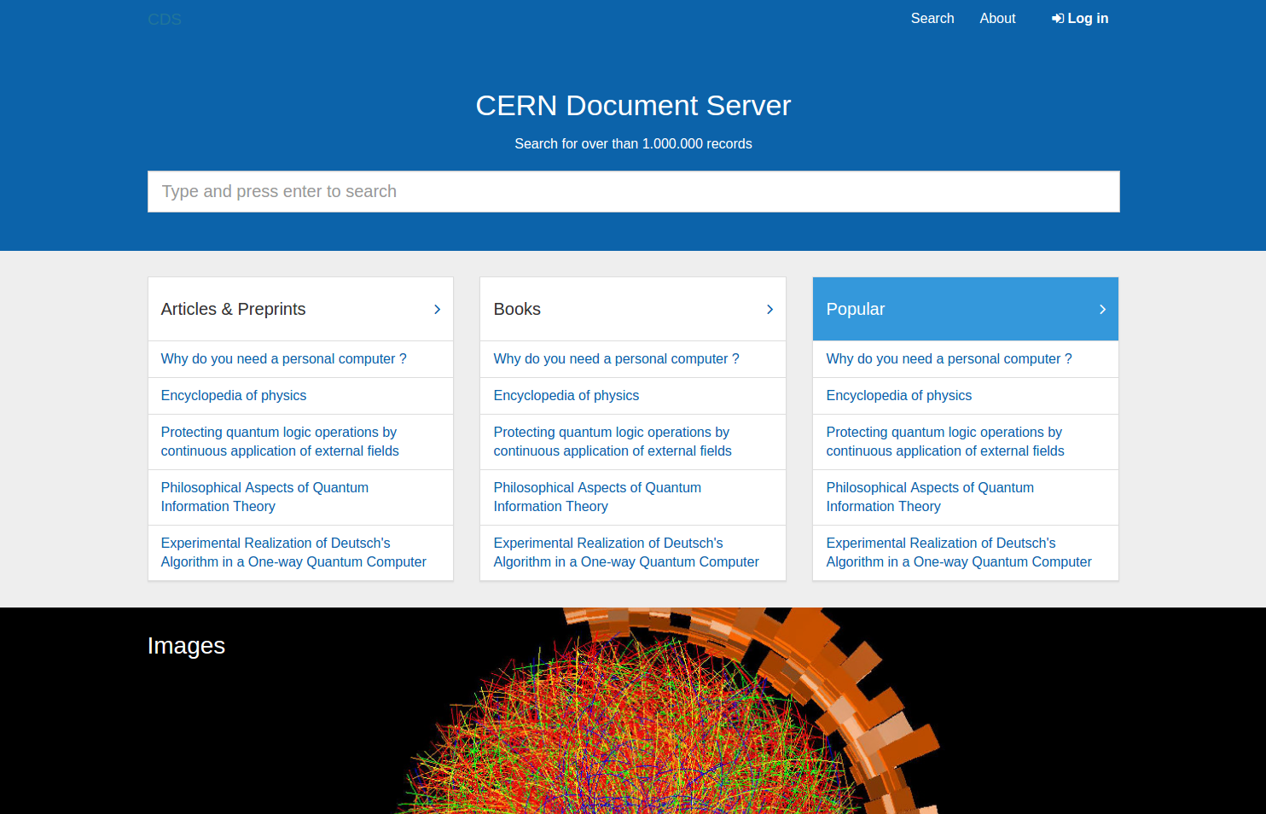
207
Publication Life Cycle at CERN Document Server
CERN Document Server hosts over 1,300,000 different documents. How does their life looks like?
Ingestion
Data is ingested from various sources through one of the workflows:
100+ submission forms created during 15 years of running CDS (don't ask how we still can still maintain them) – each tailored to meet the specific needs of a given user group.
Single- and multi-records editor – power tools for catalogers to submit the desired metadata directly.
Automatic import from other systems, like OAI Harvesting from Inspire and arXiv, batch upload from the ATLAS experiment, etc.
Curation
Ingested and indexed data is further improved through:
Automatic plots and captions extraction, cross-referencing with information from other collections or other systems (Inspire or ArXiV), automatic DOI minting.
Review process, in which the internal documents, after discussions and revisions, are being publicly published.
Authors disambiguation process that run in 2016 and, with the help of machine learning tools, enriched metadata of over 2,700,000 signatures in more that 67,000 records.
Recommendation system that, based on how people interact with CDS, suggest relevant/ or similar documents.
Export
There are multiple ways for retrieving data from CDS:
Each record can be exported in one of 7 formats: BibTeX, MARC, MARCXML, DC, EndNote, NLM and RefWorks.
Each collection of records defines it's own RSS channel.
Users can use search queries to define notifications.
Videos can be exported to YouTube or embedded on any other website.
With OAI-PMH protocol, other repositories can harvest records from CDS.
cds.cern.ch

Slide 5
207
Publication Life Cycle at CERN Document Server
CERN Document Server hosts over 1,300,000 different documents. How does their life looks like?
Ingestion
Data is ingested from various sources through one of the workflows:
100+ submission forms created during 15 years of running CDS (don't ask how we still can still maintain them) – each tailored to meet the specific needs of a given user group.
Single- and multi-records editor – power tools for catalogers to submit the desired metadata directly.
Automatic import from other systems, like OAI Harvesting from Inspire and arXiv, batch upload from the ATLAS experiment, etc.
Curation
Ingested and indexed data is further improved through:
Automatic plots and captions extraction, cross-referencing with information from other collections or other systems (Inspire or ArXiV), automatic DOI minting.
Review process, in which the internal documents, after discussions and revisions, are being publicly published.
Authors disambiguation process that run in 2016 and, with the help of machine learning tools, enriched metadata of over 2,700,000 signatures in more that 67,000 records.
Recommendation system that, based on how people interact with CDS, suggest relevant/ or similar documents.
Export
There are multiple ways for retrieving data from CDS:
Each record can be exported in one of 7 formats: BibTeX, MARC, MARCXML, DC, EndNote, NLM and RefWorks.
Each collection of records defines it's own RSS channel.
Users can use search queries to define notifications.
Videos can be exported to YouTube or embedded on any other website.
With OAI-PMH protocol, other repositories can harvest records from CDS.
cds.cern.ch

Slide 6
Publication Life Cycle at CERN Document Server
207
Ingestion
Data is ingested from various sources through one of the workflows:
100+ submission forms created during 15 years of running CDS – each tailored to meet the specific needs of a given users group.
Single- and multi-records editor – “power tools” for catalogers to submit the desired metadata directly.
Automatic import from other systems: OAI Harvesting from Inspire and arXiv, batch upload from the ATLAS and CMS experiments, etc.
CERN Document Server hosts over 1,300,000 different documents. How does their life looks like?
Curation
Export
Automatic plots and captions extraction, cross-referencing with information from other collections or other systems (Inspire, arXiv), automatic DOI minting.
Review process, in which the internal documents, after discussions and revisions, are being publicly published.
Authors disambiguation process that run in 2016 and, with the help of machine learning tools, enriched metadata of over 2,700,000 signatures in more that 67,000 records.
Recommendation system that, based on how people interact with CDS, suggest relevant or similar documents.
There are multiple ways for retrieving data from CDS:
Each record can be exported in one of 7 formats: BibTeX, MARC, MARCXML, DC, EndNote, NLM and RefWorks.
Each collection of records defines it's own RSS channel.
Users can use search queries to define notifications.
Videos can be exported to YouTube or embedded on any other website.
With OAI-PMH protocol, other repositories can harvest records from CDS.
cds.cern.ch

Slide 7
Publication Life Cycle at CERN Document Server
207
Ingestion
Data is ingested from various sources through one of the workflows:
100+ submission forms created during 15 years of running CDS – each tailored to meet the specific needs of a given users group.
Single- and multi-records editor – “power tools” for catalogers to submit the desired metadata directly.
Automatic import from other systems: OAI Harvesting from Inspire and arXiv, batch upload from the ATLAS and CMS experiments, etc.
CERN Document Server hosts over 1,300,000 different documents. How does their life looks like?
Curation
Export
Automatic plots and captions extraction, cross-referencing with information from other collections or other systems (Inspire, arXiv), automatic DOI minting.
Review process, in which the internal documents, after discussions and revisions, are being publicly published.
Authors disambiguation process that run in 2016 and, with the help of machine learning tools, enriched metadata of over 2,700,000 signatures in more that 67,000 records.
Recommendation system that, based on how people interact with CDS, suggest relevant or similar documents.
There are multiple ways for retrieving data from CDS:
Each record can be exported in one of 7 formats: BibTeX, MARC, MARCXML, DC, EndNote, NLM and RefWorks.
Each collection of records defines it's own RSS channel.
Users can use search queries to define notifications.
Videos can be exported to YouTube or embedded on any other website.
With OAI-PMH protocol, other repositories can harvest records from CDS.
cds.cern.ch

Slide 8
Publication Life Cycle at CERN Document Server
207
Ingestion
Data is ingested from multiple sources through various ways:
100+ submission workflows created during 15 years of CDS running – each tailored to meet the specific needs of a given user group.
Single- and multi-records upload – “power tools” for catalogers to submit the desired metadata and files directly.
Automatic import from other systems: via OAI-PMH protocol (e.g. arXiv.org) or import APIs (e.g. the CERN Experiments, digitisation projects, video lecture recordings).
CERN Document Server hosts over 1,300,000 different documents. How does their life looks like?
Enrichment
Dissemination
Automatic extraction of plots and captions, cross-reference with information from other collections or other systems (Inspire, arXiv), automatic DOI minting.
Review process, in which the internal documents, after commenting rounds and revisions, are published.
Authors disambiguation project using machine learning algorithms that enhanced the metadata of 67,000 records with more than 2,700,000 author signatures.
Recommendation system suggesting relevant or similar documents based on previous users' interactions with CDS.
Records can be exported in one of 7 formats: BibTeX, MARC, MARCXML, DC, EndNote, NLM and RefWorks.
Support for open standards: oEmbed, OpenGraph, OpenSearch, OpenURL.
Each collection of records defines it's own RSS channel.
Users can set up notifications based on previous search queries.
Videos can be exported to YouTube or embedded on any other website.
Public CDS records can be harvested through OAI-PMH protocol.
cds.cern.ch

